Slide 1
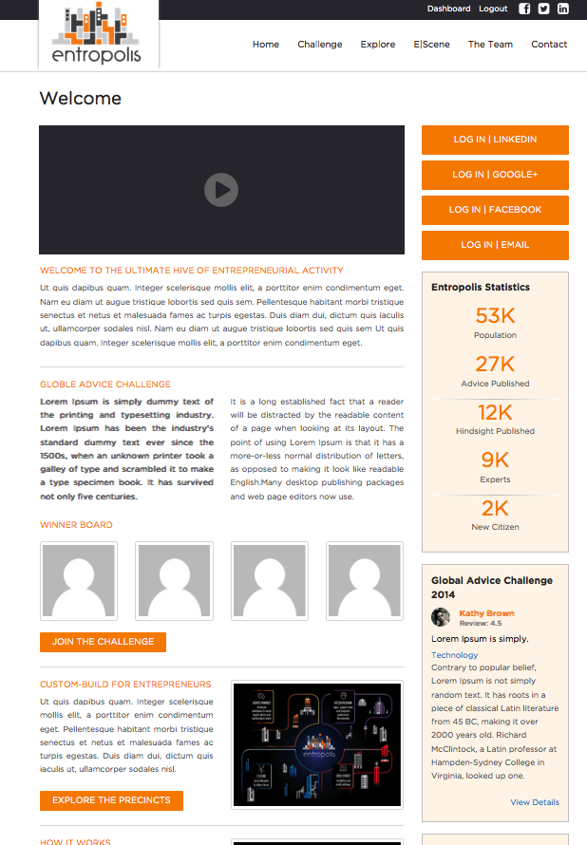
Home
Citizenship
WELCOME TO THE ULTIMATE HIVE OF ENTREPRENEURIAL ACTIVITYTM
Entropolis is a fully curated online ecosystem and powerful private business network for entrepreneurs, providing an enabling environment and fast access to a curated collection of vital resources to help build successful, fast growth businesses in the real world.
REGISTER | EMAIL
REGISTER | LINKEDIN
INFOGRAPHICS PANEL
Total Population | Sage Advice | Hindsight Wisdom
MEET OUR CITIZENS
Entropolis is a colony built by entrepreneurs for entrepreneurs. Here you can connect and collaborate with game-changers, visionaries, innovators, entrepreneurship experts and thought leaders from around the globe. With your fellow citizens, you will share wisdom, ideate, test, learn discuss, collaborate and build out your business ideas.
E|LUMINATI
Invited as patrons of Entropolis, these are true legends of the entrepreneurial world.
With an abundance of experience and wisdom, they are our inspiration.
SAGES
With notable success these are the entrepreneurs and expert advisors who can advise and support entrepreneurs to achieve high performance and fast growth businesses
SEEKERS
The future rockstar entrepreneurs!
These citizens have joined Entropolis to contribute but also to learn from the best.
They are still on their entrepreneurial journey.
E|LUMINATI
Rotator Panel for e|Luminati head shots and testimonial only. When you click on a head you will go to the e|Luminati profile page.
HELP US PIONEER THE FUTURE COLONY FOR ENTREPRENEURS ...
We invite you to help us build this colony and reap boundless rewards.
As one of the first 1500 successful applicants, you will be recognized as a Pioneer Seeker or Sage. the founding Citizens of Entropolis.
And for the first 6 months you will enjoy free membership.
Before we launch globally, we are looking for trailblazing Australian entrepreneurs and entrepreneurship experts to be our Founding Citizens of Entropolis. This our chance to profile the massive talent in our ecosystem and take your awesomeness to the world!
HOW TO BE A PIONEER
REGISTER
Normally there will be a number of hurdles to step over before you are accepted as a citizen. As a pioneer you will be awarded citizenship immediately and the first 6 months of membership will be free.
SHARE YOUR HINDSIGHT WISDOM
Combined experience and wisdom are the powerhouse of Entropolis. Enter the decisions you have had to make as an entrepreneur – the good, the bad and the downright ugly – and your corresponding hindsight wisdom into Decision Bank for the benefit of all.
OR SHARE YOUR SAGE ADVICE
If you are an expert, go to the Advice Publishing App to share your insights and expertise.
SHAMELESSLY PROMOTE
Don’t be shy! Please introduce Entropolis to your network so they can all be pioneers of this entrepreneurial crusade.
BE HONEST
We need your feedback through this iterative development phase. This is your chance to mould the city’s infrastructure to your needs.
REGISTER | EMAIL
REGISTER | LINKEDIN
SAGE ADVICE
Rotator panel for advice flowing into the system. This will update in real time advice entering the system via the advice|market publishing tool or back end feed
SEEKER WISDOM
Rotator panel for new HINDSIGHT flowing into the system. This will update in real time hindsight entering the system via the decision|bank tool or back end feed
PIONEER BENEFITS
Entropolis is a start-up and we are in Beta. That means you are looking at our MVP. As pioneers we know you are used to roughing it, but we really want you to join the colony. So, we’ve added a bit of extra incentive. Consider this a technology version of ‘glamping’!
1
2
3
4
We will launch Entropolis with full functionality on 7 January 2015. However, this is your colony and we need your help building it so it can truly add value to the global community of entrepreneurs.

Slide 2

Home
Citizenship
MEET OUR CITIZENS
Entropolis is a fully curated online ecosystem and powerful private business network for entrepreneurs, providing an enabling environment and fast access to a curated collection of vital resources to help build successful, fast growth businesses in the real world.
E|LUMINATI
Entropolis is a fully curated online ecosystem and powerful private business network for entrepreneurs, providing an enabling environment and fast access to a curated collection of vital resources to help build successful, fast growth businesses in the real world.
E|LUMINATI
Head shot and testimonial only. When you click on a head you will go to the profile page.
E|LUMINATI
Head shot and testimonial only. When you click on a head you will go to the profile page.
E|LUMINATI
Head shot and testimonial only. When you click on a head you will go to the profile page.
E|LUMINATI
Head shot and testimonial only. When you click on a head you will go to the profile page.
E|LUMINATI
Head shot and testimonial only. When you click on a head you will go to the profile page.
E|LUMINATI
Head shot and testimonial only. When you click on a head you will go to the profile page.
E|LUMINATI
Head shot and testimonial only. When you click on a head you will go to the profile page.
E|LUMINATI
Head shot and testimonial only. When you click on a head you will go to the profile page.
E|LUMINATI
Head shot and testimonial only. When you click on a head you will go to the profile page.
E|LUMINATI
Head shot and testimonial only. When you click on a head you will go to the profile page.
SEEKERS
Entropolis is a fully curated online ecosystem and powerful private business network for entrepreneurs, providing an enabling environment and fast access to a curated collection of vital resources to help build successful, fast growth businesses in the real world.
ROLE AND RESPONSIBILITIES
SAGES
Entropolis is a fully curated online ecosystem and powerful private business network for entrepreneurs, providing an enabling environment and fast access to a curated collection of vital resources to help build successful, fast growth businesses in the real world.
ROLE AND RESPONSIBILITIES
HOW TO BE A PIONEER CITIZEN
1. REGISTER
The first thing to do is click through and register! Normally there will be a number of hurdles to step over before you are accepted as a citizen. As a pioneer you will be awarded citizenship immediately and the first 6 months of membership will be free.
2. SHARE YOUR WISDOM
Combined experience and wisdom are the powerhouse of Entropolis.
Enter the decisions you have had to make as an entrepreneur – the good, the bad and the downright ugly – and your corresponding hindsight wisdom into Decision Bank for the benefit of all.
OR
If you are an expert, go to the Advice Publishing App to share your insights and expertise.
3. SHAMELESSLY PROMOTE
Don’t be shy! Please introduce Entropolis to your network so they can all be pioneers of this entrepreneurial crusade.
4. BE HONEST
We need your feedback through this iterative development phase. This is your chance to mould the city’s infrastructure to your needs.
REGISTER | EMAIL
REGISTER | LINKEDIN

Slide 3
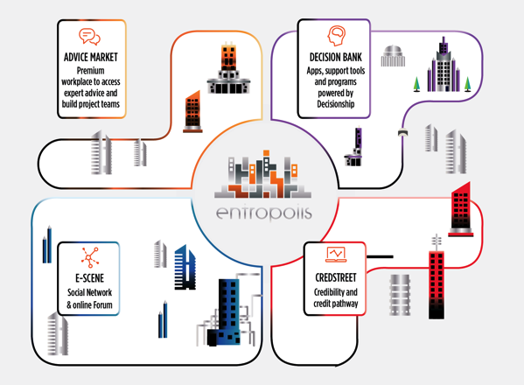
Home
Citizenship
Explore
EXPLORE YOUR NEW COLONY
Entropolis is a fully curated online ecosystem and powerful private business network for entrepreneurs, providing an enabling environment and fast access to a curated collection of vital resources to help build successful, fast growth businesses in the real world.
We are a start-up! This is a gorgeous MVP, but it is still our MVP. Your constructive feedback as Founding Citizens will help us to finesse the four ultimate precincts of the Entropolis, laying the foundations for what will ultimately be the ultimate global hive of entrepreneurial activity.
Custom-built platform with four integrated interactive precincts where entrepreneurs play the game of business with real-world business outcomes.
Real-time access to high quality, curated advice and hindsight wisdom from a fully vetted global community of expert advisors, mentors and peers.
Virtual workplace where entrepreneurs can source critical services and collaborate with service providers to model and execute their business vision.
Proprietary interactive education tools and apps to help entrepreneurs make faster, better decisions and build their businesses with less angst
Gameified system where participation builds entrepreneurial profile and ultimately pathways to funding and other high value resources.
REGISTER | EMAIL
REGISTER | LINKEDIN
INTEGRATED CITY PRECINCTS
EVERYTHING YOU NEED IN ONE PLACE TO WIN AT THE REAL-WORLD GAME OF BUSINESS
The game-fied ecosystem features four integrated city precincts and provides credible, guided pathways and proprietary tools for entrepreneurs seeking expert advice, peer hindsight wisdom and education to enhance decision-making, or to engage teams to collaborate on and eventually fund their business ideas.
ADVICE|MARKET
A virtual workplace where where you can build your A-Team to ideate, test and build out your business idea.
Seek and search quality advice, create projects, and identify and collaborate with teams of expert advisors to help you start, grow and exit your business faster.
Our Sages and expert service providers will set up shop in here so you can connect and collaborate with them anytime of the day or night!
DECISION|BANK
Our central repository of entrepreneurial knowledge! Here you can access a powerful, global archive of entrepreneurial hindsight wisdom, education and proprietary tools to help you make better business decisions. To save you innumerable hours and frustrations, our team works diligently to curate the best entrepreneurial wisdom from across the globe.
As citizens you contribute to this archive and the betterment of our colony by entering your decisions and hindsight wisdom into the Decision⎪Bank.
CRED|STREET
There are many benefits as a citizen of Entropolis. One is the opportunity to build your Entrepreneurship profile within a qualified, global community of entrepreneurs. Establishing your credibility here can facilitate connections which may help with future business opportunities, seeking funding and even connecting with other citizens to build a high performance virtual business team.
E|SCENE
An Entropolis members only social network and online forum for sharing thoughts, ideas and challenges and collaborating to build better concepts and more sustainable businesses.
On a Friday night this is the place to be! Okay, well maybe not. But E⎪Scene is the place to go when you want to connect with your peers an open discussion forum.
WHAT MAKES OUR COLONY GREAT ... THE FACTS!
Entropolis is being built by Australians, in Australia for the global entrepreneurial community.
We are passionate about entrepreneurialism and we want to help other entrepreneurs to succeed.
Being an entrepreneur can be lonely and stressful. There are so many challenges, and opportunities it’s impossible to imagine them all when you get started.
Entrepreneurs are confronted by a mind-boggling array of articles, courses, coaches and people claiming to be specialist advisers. It is incredibly time consuming sifting through this volume to find good advice, mentors, collaborators, partners and investors.
We want to make it easier for you to find each other, and the information you need, in a non-competitive and supportive online community.
Entropolis is purpose-built for entrepreneurs and their advisers. Here you can share, vent, test, ideate, advise, mentor and collaborate.
Entropolis is aggressively exclusive. It’s not because we don’t like to play nicely with others! It’s because we are absolutely committed to quality in all things. Advice. Services. Advisers. Investors. And of course the entrepreneurs in the Entropolis ecosystem. We tightly control all of these to create a more valuable community for you.
All information has been carefully curated to ensure this entrepreneurial colony is founded on quality advice. Only the best for our citizens!
We are looking for Australian entrepreneurs who want to get in early as Founding Citizens of Entropolis, before we launch into other markets. This our chance to say “Thanks!” and to acknowledge on a global platform the people doing great things in our local community of entrepreneurs.
There are only 1,500 Founding Citizenships available so you need to sign up quickly! As a Founding Citizen you will enjoy:
6 months free Entropolis membership giving you 6 months to develop a robust health profile
Founding Citizen Icon on your profile in perpetuity
Free use of the Decisionship tools
REGISTER | EMAIL
REGISTER | LINKEDIN

Slide 4
Home
Citizenship
E|Scene
CONNECT, COLLABORATE, HANGOUT
Entropolis is a fully curated online ecosystem and powerful private business network for entrepreneurs, providing an enabling environment and fast access to a curated collection of vital resources to help build successful, fast growth businesses in the real world.
LOG|IN
REGISTER | EMAIL
REGISTER | LINKEDIN

Slide 5



Home
Citizenship
The Team
PROUD TO CALL OURSELVES THE “E|TEAM”
Entropolis is a fully curated online ecosystem and powerful private business network for entrepreneurs, providing an enabling environment and fast access to a curated collection of vital resources to help build successful, fast growth businesses in the real world.
TANIA PRICE
Founder and CEO
ENTREPRENEUR | STRATEGIC BRANDING AND COMMUNICATIONS EXECUTIVE | IDEAS ARCHITECT | BUSINESS DIRECTOR | INVESTOR
Possessing a rare combination of strategic and creative vision, commercial acumen, management and leadership expertise, Tania is passionate about applying her corporate and entrepreneurial experience to support and foster entrepreneurship on a global scale.
Tania’s experiences have given her unique insight on business ecosystems, and led her to identify gaps in the quality, value and accessibility of advice and advisory services that are on offer for entrepreneurs.
With the launch of Entropolis, she aims to harness the power of technology to bring together entrepreneurs, entrepreneurship experts and advisors who will network, share wisdom, create teams and collaborate to build the next generation of game changing, peak performance and investment attractive businesses.
MYSTERIOUS
TECH GUY
MARC RAGSDALE
Partner and Mysterious Tech Guy
LIFELONG ENTREPRENEUR | INTERNATIONAL BUSINESS AND TECHNOLOGY CONSULTANT | FUTURE THINKER | NEW DIGITAL TECHNOLOGY INVENTOR
Marc brings to Entropolis extensive experience in both open source and proprietary technologies, assisting venture-funded startup companies define and execute their technology requirements, and executing technology projects of all types and specialities.
His background in coding and substantial experience in system analysis and architecture, combined with a clear understanding of business strategy, processes and objectives has proved invaluable in his collaboration with Tania to architect the large scale Entropolis platform.
TRENNA PROBERT
Strategy and Business Director
ENTREPRENEUR | BUSINESS STRATEGIST | CORPORATE ADVISER | INVESTOR | BUSINESS DIRECTOR
Trenna is a strategic thinker who leverages her innate creative ability with proven commercial skills to deliver innovative solutions to business problems. Bringing together more than twenty years’ experience working with start-ups, small businesses and in multi-national corporations, Trenna has a unique perspective on the challenges and opportunities companies face. She seeks to add value by maximising revenue potential and minimising revenue risk.
Trenna has spent the last few years focusing on leveraging her corporate financial services and consulting experience within the start-up community. Specifically she applies her experience developing client focused, commercially honed go-to-market strategies and raising capital from high net worth and institutional markets.
ABBE BARNES
Entrepreneur Community Manager
.
Marc brings to Entropolis extensive experience in both open source and proprietary technologies, assisting venture-funded startup companies define and execute their technology requirements, and executing technology projects of all types and specialities.
His background in coding and substantial experience in system analysis and architecture, combined with a clear understanding of business strategy, processes and objectives has proved invaluable in his collaboration with Tania to architect the large scale Entropolis platform.

Slide 6
Home
Citizenship
Contact
GET IN TOUCH
Entropolis is a fully curated online ecosystem and powerful private business network for entrepreneurs, providing an enabling environment and fast access to a curated collection of vital resources to help build successful, fast growth businesses in the real world.
LOG|IN
REGISTER | EMAIL
REGISTER | LINKEDIN
ENTROPOLIS PTY LTD
ACN:
Level 3 | 50 York Street
Sydney NSW 2000
Ph: 1300 xxx xxx
E: citizens@theentropolis.com
WE LOVE VISITORS!
Entropolis is a virtual world, but behind it lies some very real people.
If you would like to connect in person, you can find us here:
MAP
IF YOU HAVE ANY QUESTIONS, SUGGESTIONS OR WOULD JUST LIKE TO CONNECT WITH US, PLEASE US AN EMAIL AND WE WILL RESPOND WITHIN 24 HOURS.
FIRST|NAME
LAST|NAME
EMAIL|ADDRESS
RE|
MESSAGE|
LET US KNOW YOU’RE NOT A MACHINE! Type in the security code.
AGGEGEG
Reload if you can’t read it clearly.
SEND

